Slide 1

Design and Development of Advanced Steering System for Low Speed Applications
Saksham Verma Shreyas Shanker Govind Ajith Kumar
15BMA0008 15BMA0009 15BMA0013
B Tech (VIT)

Slide 2
Motivation
The works conducted in the project can be applied to various low speed applications.
The application can be further extended to agriculture, warehouses and rovers.
Mechanical
Electronics
Hydraulic

Slide 3
Timeline
Deciding the speed range for application
CAD Development for the rear end
Rear end quarter assembly and testing
CAD Development for the front end
Front end testing and assembly
DC Motor and Stepper Motor Test for the rear end
Aluminium Frame machining and preparation for assembly
Front end steering geometry design as per Ackerman Steering Principle
Front end Stepper motor driver (L298n) electronics and rack and pinion selection
DC Motor Driver selection resulting in the chosen L298n motor driver
Complete electronics soldering on perfboard along with the Arduino MEGA Microcontroller
Full model integration using 2 Arduino UNOs
Turning Circle Radius (TCR) measurement and validation
Evaluation and confirmation of the reduction in the TCR
Hydraulic Design and Assembly
Prototype controller design and joystick correction

Slide 4
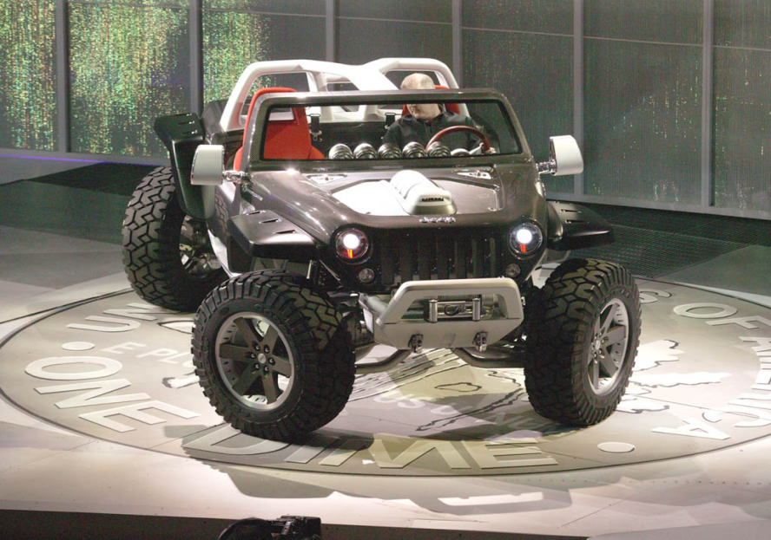
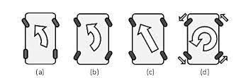
Advanced Steering System
Steering system can steer the vehicle using all the four wheels
Two modes of steering:- In-phase and Counter-phase
Also Includes Zero Turn Steer

Slide 5
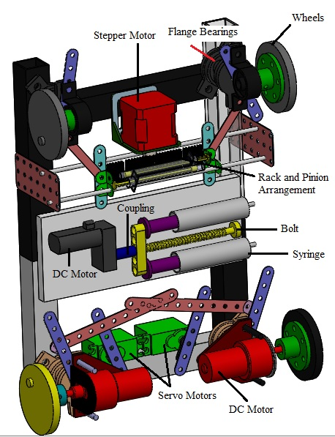
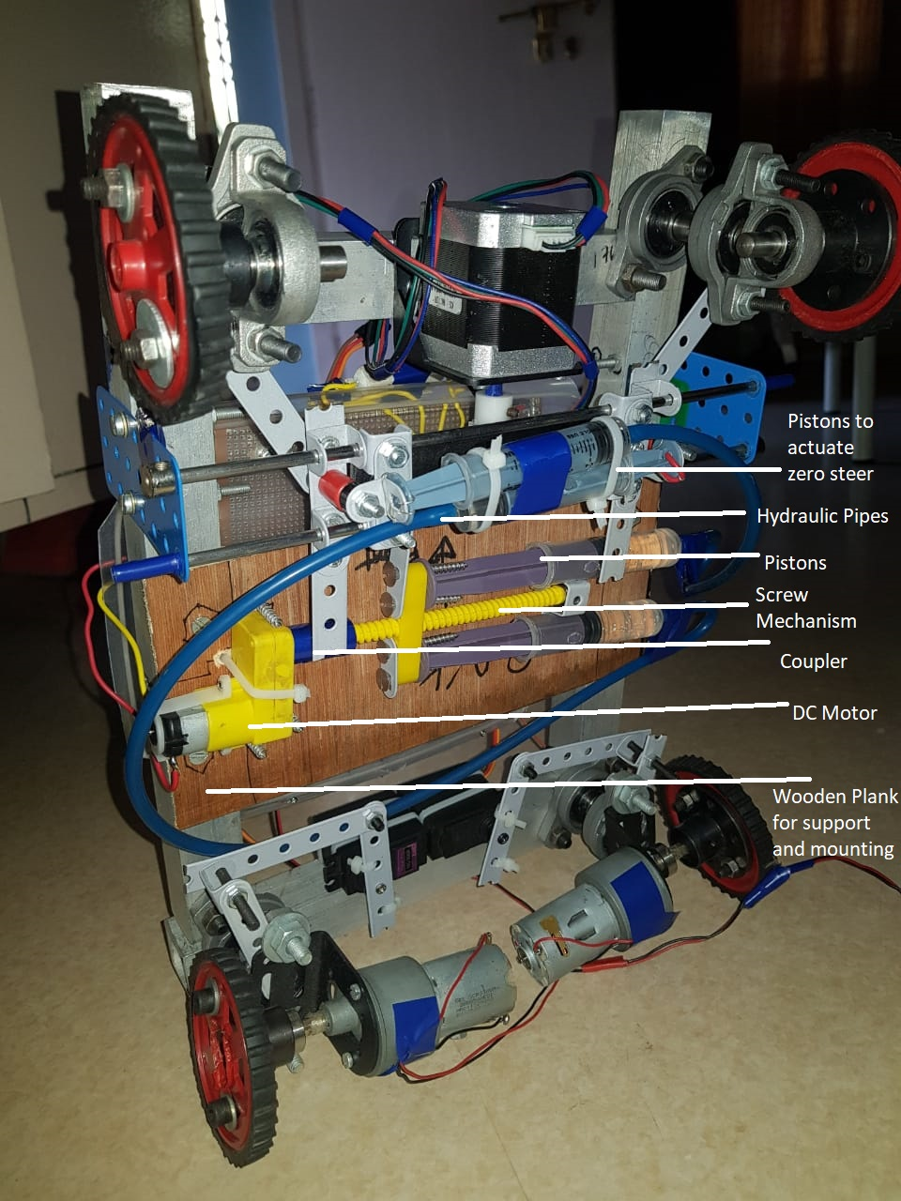
Design and Development of Prototype
Wheelbase and Track width derived from recommendations of the W.H.O handbook for wheelchair design.
CAD Model
Actual Prototype

Slide 6
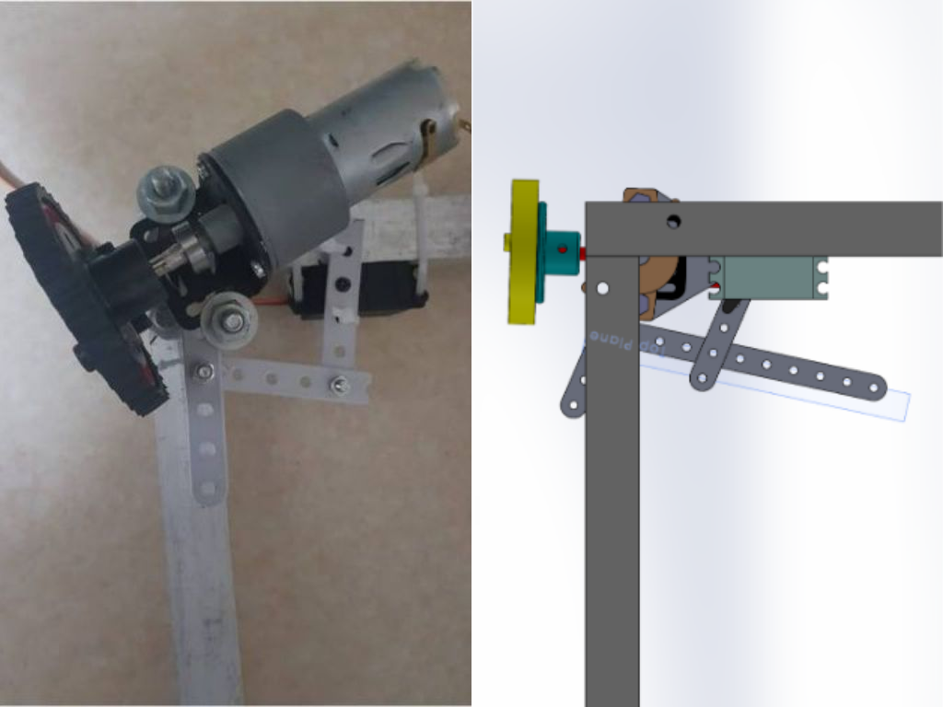
Mechanical Design and Development of Prototype
Stages of Design:-
Geometry is decided
CAD model is made according to the parts available
CAD model is checked for interference of parts and other discrepancies
Manufacturing of model is carried out
Multiple iterations were carried out
Actual Prototype VS CAD Model

Slide 7
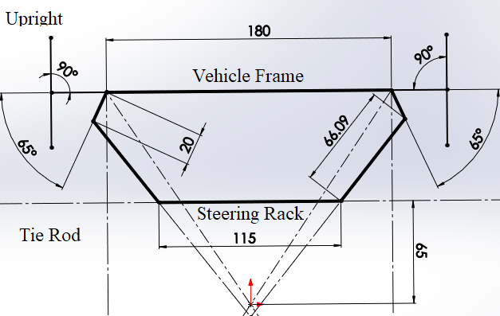
Steering geometry
The input variables were:
Rack length
Tie rod length
Distance and position of tie rod at the wheel end relative to wheel pivot points
Geometric iterations were tested using SolidWorks, the following trends with respect to input variables was established while the other variables are kept constant
change in (*) | Max Toe in | 4WS Ackerman Compliance | Straight Ahead Condition
Rack length | Decreases | Increases | Toed in
Tie rod length | Increases | Decreases | Toed in
Distance from pivot point | Increases | Decreases | Toed in
Angular displacement | Increases | Decreases | Toed in

Slide 8
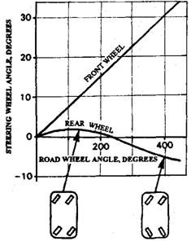
Relation between Steering Wheel angle and Road wheel turning angles (Front and Back)
> At low speeds, when tighter turns are needed, a typical driver turns the front tyres as much as possible for the maximum turning space efficiency.
> Conversely, at high speeds the steering is turned only a little to shift lanes or turn at a large radius as the road bends.

Slide 9
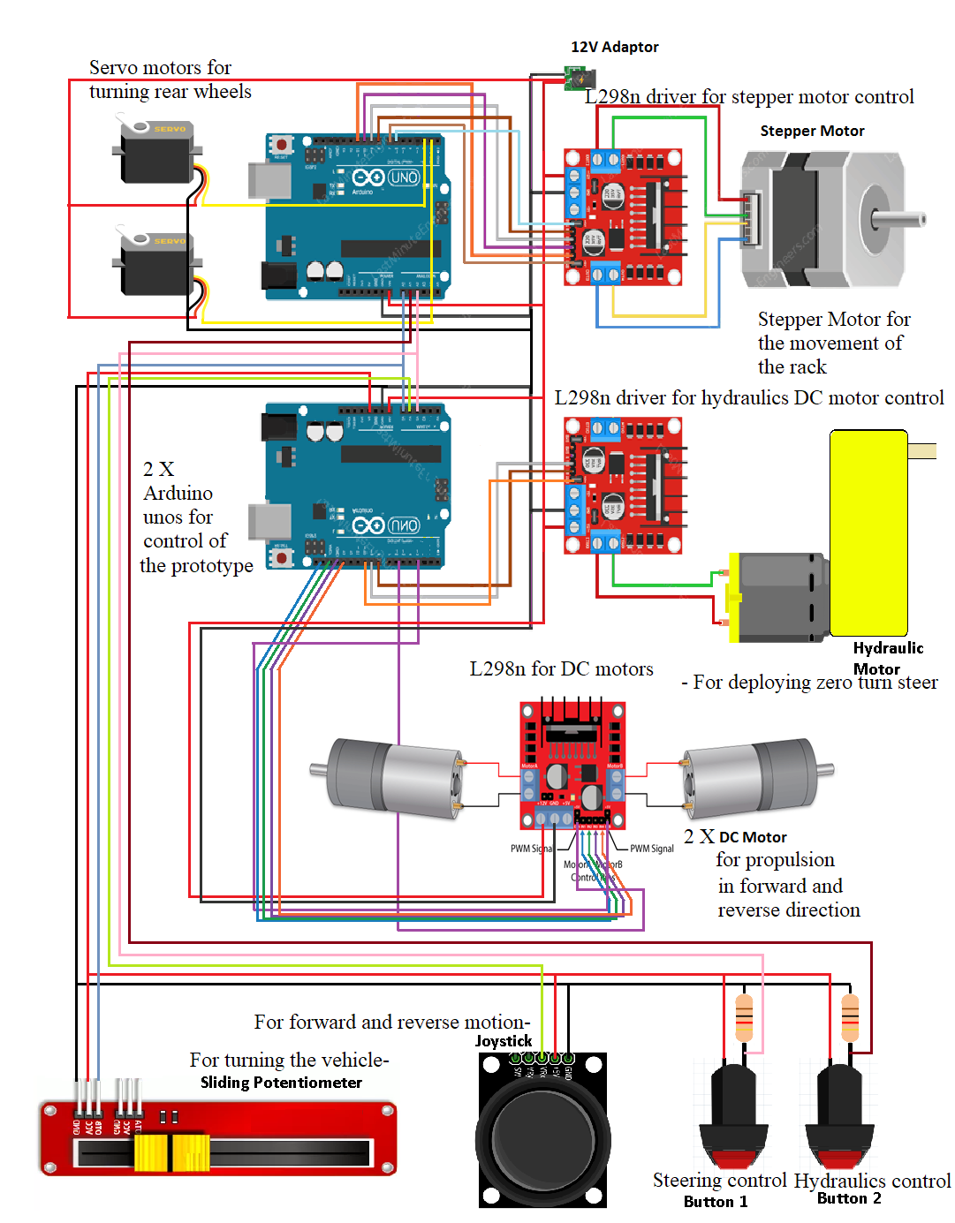
Electronics Circuit Design
Arduino Uno X2
DC motor
Servo motor X2
Stepper Motor
Small DC motor
L298N driver X3
Joystick
Slider
Switches X3
12V Adapter
5Ω Resistors X2
Full list of electricals

Slide 10
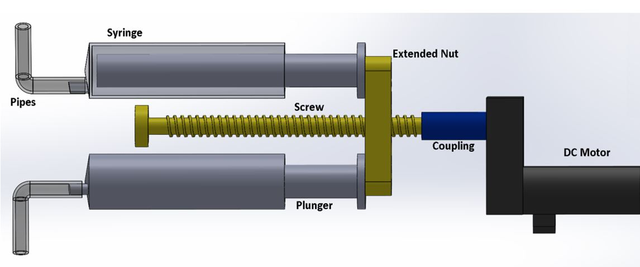
Hydraulic System
Hydraulic system is used to alter the length of the rack as required to switch between various steering modes
Uniquely suited for the purpose of the prototype
Easily incorporated with vehicles which already utilise pressurised liquids
Constructed as two separate cylinder pairs (Construction)

Slide 11
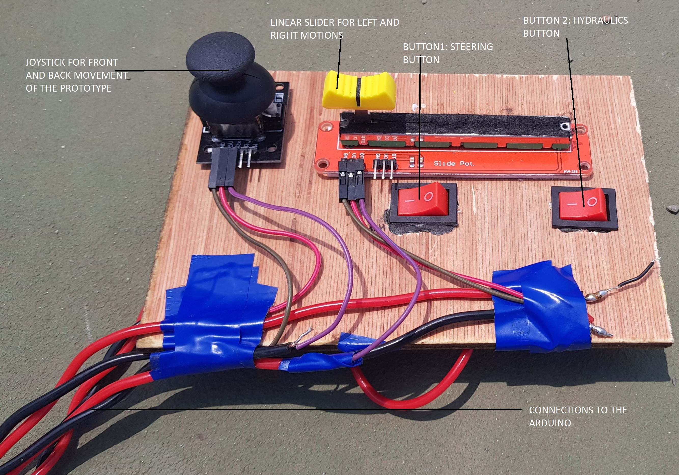
Prototype Control
The prototype is controlled
using a remote module
consisting of a joystick,
linear potentiometer and
two switches.
Additionally, there is
another switch on the
prototype for emergency
switch off.

Slide 12

Demo Video

Slide 13
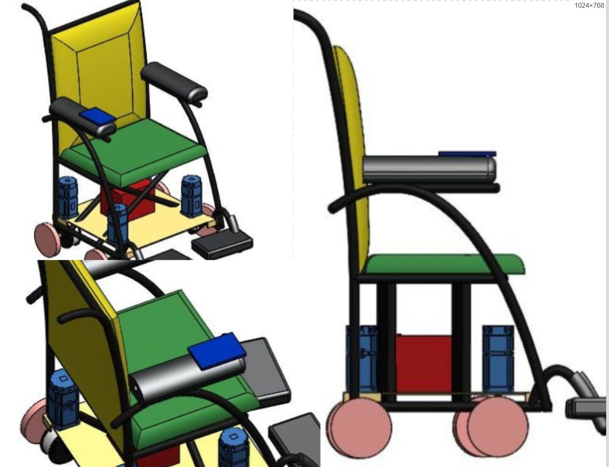
Extension of the prototype design to a Wheelchair
Based on learnings from prototype design
All four wheels are independently steered using stepper motors
Capable of navigating through narrow corridors with ease

Slide 14
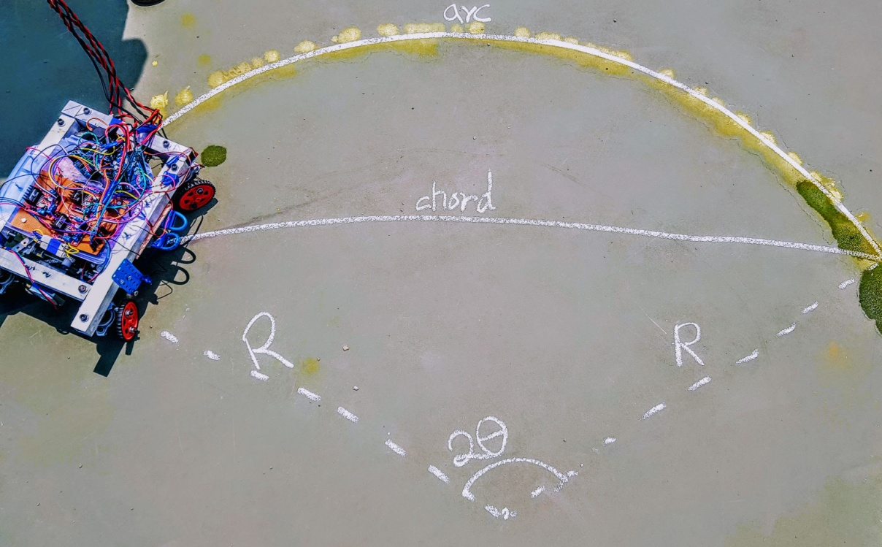
Testing Methodology
The vehicle was attached with a reservoir to drip water onto the tyres, which can trace the desired path
Arc and chord measurements are recorded
Radius of the circle is calculated from the arc length (l) and the length of the chord (c).

Slide 15
Results
S. No | Inner Angle | Outer Angle | 2W- TCR | 4W-TCR | Experimental % reduction
 | (Degree) | (Degree) | (mm) | (mm)
1 | 45 | 23 | 752.90 | 383.20 | 49.10
6 | 40 | 22 | 1113.20 | 459.40 | 58.73
11 | 35 | 20 | 1291.10 | 516.70 | 59.98
16 | 30 | 18 | 1312.80 | 533.00 | 59.40
21 | 25 | 16 | 1723.60 | 623.50 | 63.83
26 | 20 | 14 | 1863.10 | 836.20 | 55.11
A maximum reduction percentage of 63.82 % and a minimum reduction of 49.10 % are observed.

Slide 16
Challenges Faced
Challenge faced | How we overcame
Front end geometry construction | Had to resort to Allen bolts for improved robustness
Thermal issues | Added resistors of 5 ohms to reduce the current, thereby protecting the L298n driver
Servo motor return to home | Replacement of Servo
Stepper skipping steps | increased current to the stepper
Pillow Bearing | Ordered replacements for better seating of the front wheels
Slider out of position | Stoppers on either ends
Electronics packaging | Soldering and perf board helped with reduction of a large number of wires
Rack And pinion mate improper | Changed rack height, mounting and length for perfect mate
Rear wheel toe-in | Used rest-angles in code to correct for mechanical toe

Slide 17
Conclusion
4WS and Zero turn steer help to significantly reduce the TCR
Important for real world applications – Shrinking space, Increased Congestion
A maximum reduction percentage of 63.82 % and a minimum reduction of 49.10 % are observed.
A goal of 20 % was set at the beginning of the project, but this target was surpassed very successfully.
We have successfully published a research paper in the “Journal of Emerging Technology and Innovative Research” in ICAMCE 2019, held in Mumbai.
We have also presented our findings at the International Conference on Progress in Automotive Technologies (ICPAT-2019) held at VIT Vellore

Slide 18
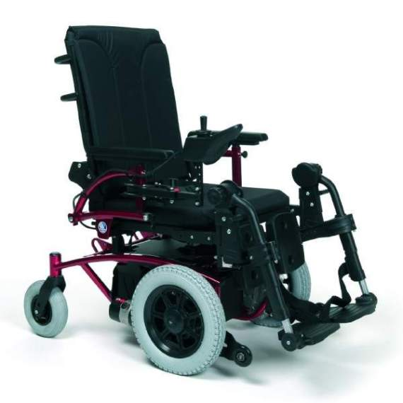
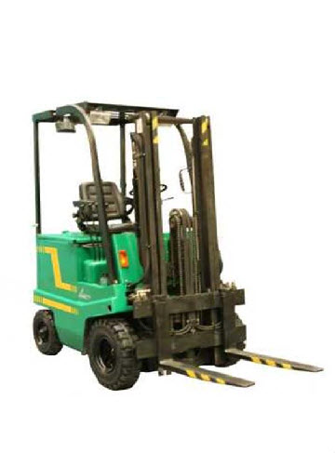
Applications
Varied warehouse applications
In-house wheel chair
Rovers
Low speed robots
Vehicles with separate trailer
Construction
Unmanned vehicles for military and off-road applications
All Terrain Vehicles (ATV)
Challenges:
Packaging
Effect on Dynamics
Reliability (Increased moving parts)

Slide 19
Thank you
Questions ?

Slide 20


Timeline
Topic finalization | 05 December 2018 | 05 December 2018
Literature Survey | 06 December 2018 | 05 January 2019 | 24 days
Report Preparation | 10 December 2018 | 03 May 2019 | 106 days
Simulations | 11 December 2018 | 30 April 2019 | 102 days
MS Project plan | 12 December 2018 | 03 January 2019 | 18 days
PPS Approval and final signature | 14 December 2018 | 14 December 2018
Steering mechanism finalization | 15 December 2018 | 30 December 2018 | 12 days
Selection of Motors | 06 January 2019 | 10 January 2019 | 5 days
Building of Electronic Circuits | 10 January 2019 | 15 March 2019 | 47 days
ARDUINO Coding for the motors | 10 January 2019 | 10 March 2019 | 43 days
Designing of component layout | 10 January 2019 | 15 January 2019 | 4 days
Review 1 | 14 January 2019 | 14 January 2019
Making final CAD model | 15 January 2019 | 25 January 2019 | 9 days
Ordering of Parts for the prototype | 25 January 2019 | 01 March 2019 | 26 days
Testing of Electronic Circuit before assembly | 01 February 2019 | 15 February 2019 | 11 days
Review 2 | 18 February 2019 | 18 February 2019
Building of prototype | 20 February 2019 | 15 March 2019 | 18 days
Testing final prototype | 16 March 2019 | 01 April 2019 | 12 days
Measurement of TCD | 01 April 2019 | 05 April 2019 | 5 days
Calculation and verification of Results | 10 April 2019 | 15 April 2019 | 4 days
Final observations and optimization | 15 April 2019 | 01 May 2019 | 13 days
Report modification | 06 May 2019 | 12 May 2019 | 6 days
Final Review | 31 May 2019 | 31 May 2019
 | COMPLETED ON TIME TASKS
 | COMPLETED WITH SLIGHT DELAY
 | PENDING TASKS

Slide 21
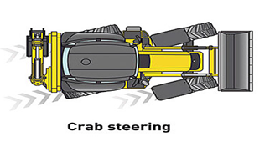
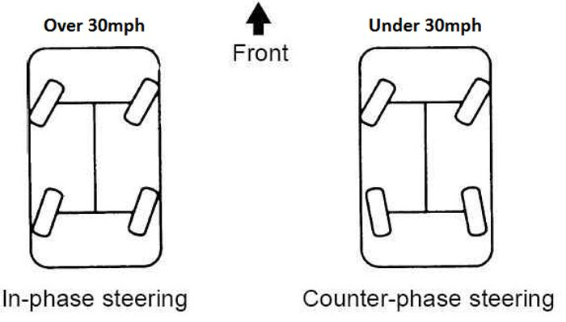
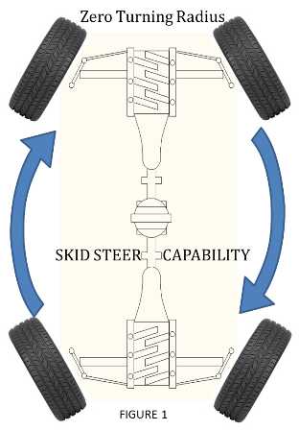
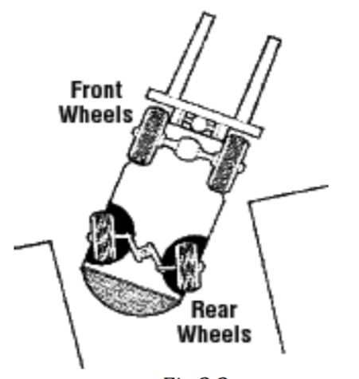
Advanced Steering System
Notes:
Rear wheel steering tends to be unstable due to the steering geometry thereby increasing the chances of oversteer. A rear wheel steered vehicle turns in the direction opposite of how it is initially steered, making it confusing for the driver. A rapid steering input will cause two accelerations. First in the direction that the wheel is steered, and then in the opposite direction, a sort of reverse response. Above-mentioned reasons make rear-only steered vehicles uncommon in use

Slide 22
Zero turn Steer
Zero turn steering involves changing the wheel angles of the front and rear wheels such that the vehicle can turn about its geometric centre, making the theoretical turning radius zero.
Advantages
Superior cornering: The vehicle can take turns around smaller corners, in roads with lesser width.
Improved steering response: Since the rear assist is electronically controlled, the overall steering response would be smoother at any vehicle speed.
High speed stability and lane changing: As the crab steer kicks in at high speeds; the vehicle will feel more stable and in-control while changing lanes can perform this manoeuvre faster.
Smaller turning radius: The imaginary centre of turning of the vehicle comes closer as the rear wheel turning angle increases out-of-phase, giving a smaller turning circle radius which is helpful in all sort of situations like turning, parking, and backing out of tight corners, manoeuvring in tight spaces and taking U-turns.

Slide 23
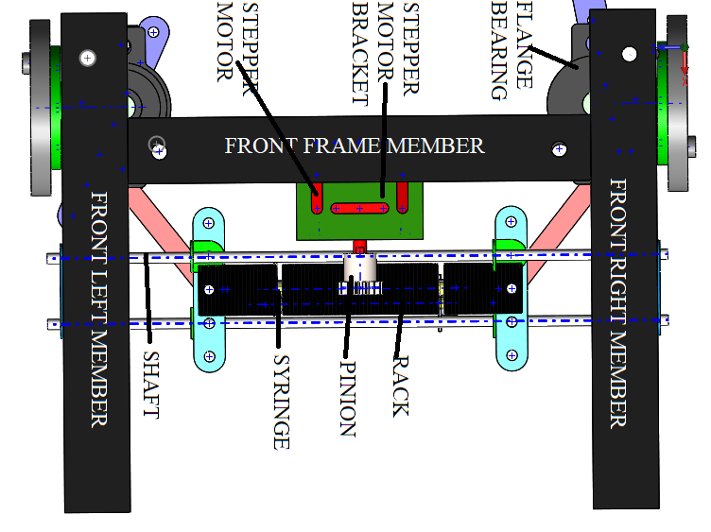
Front End Design
Having had the rear end designed full of electronics, the front end was decided to have a combination of mechanical and hydraulic layout. The decision was made to make a rack and pinion system coupled with a hydraulic system t enable zero steer. Unlike the rear end, the front end was developed with just one motor. The stepper motor is to depict a steering wheel.

Slide 24
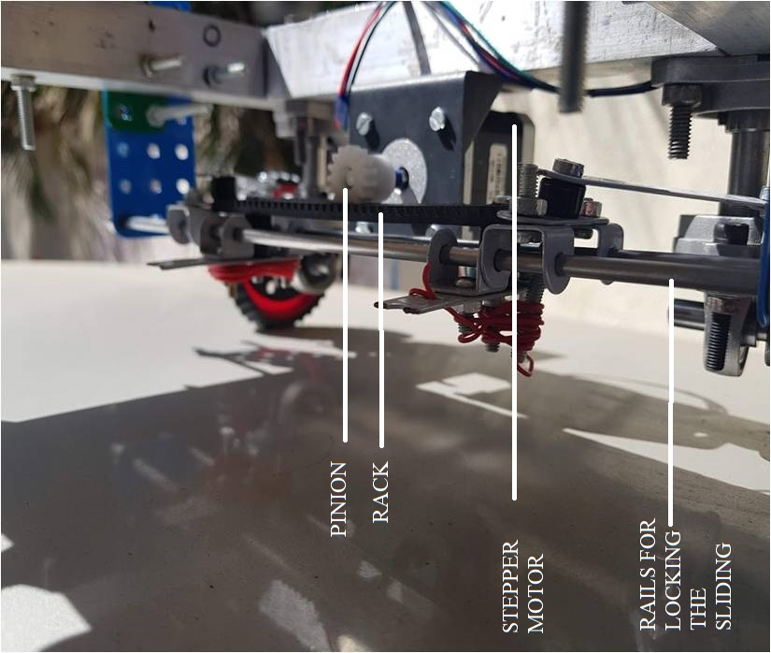
Front End Design
The Ackermann steering geometry for this prototype was designed with three main goals:
The wheels must be able to toe-in sufficiently attain zero steer conditions when rack is extended
To have the appropriate amount of toe in on the outer wheel upon maximum lock of inner wheel during turning.[18]
Wheels must point straight ahead when the rack is centred

Slide 25
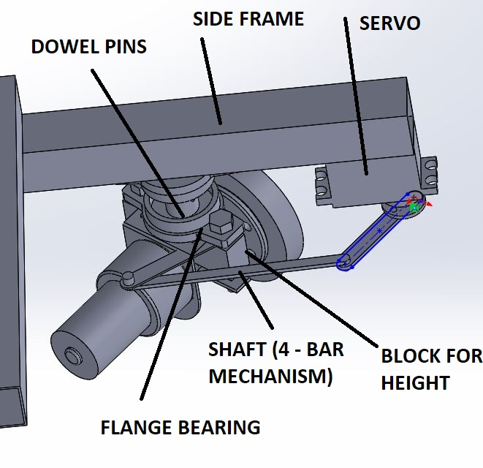
Rear End Design
The rear end design was largely driven by the position of the servo motors, its shafts, DC motors and the wheel hub. The wheel diameter also played a role in deciding the ride height of the vehicle.
Servo motor was set to rotate a rotating disk, with an attached shaft. The shaft was mounted onto the DC motor bracket, which causes the wheels to turn.
The rear end frame length was decided in such a way so as to leave just enough space between the DC motors, especially at their closest point of interaction which is during straight ahead position.

Slide 26
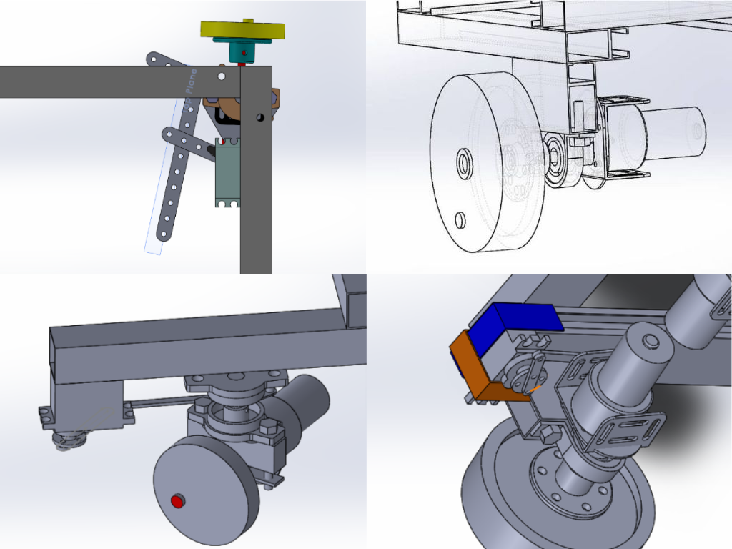
Iterations
Oldest to Newest in
clockwise from Top-
Right

Slide 27
Electrical and Electronics
The electronic components fulfill the following functions in the model:
Allow the vehicle to move linearly
Make rear wheels turn at independent angles
Make front steering geometry turn any required angle
Control the timing, degree and duration of every actuator movement thereby deciding vehicle motion and path

Slide 28
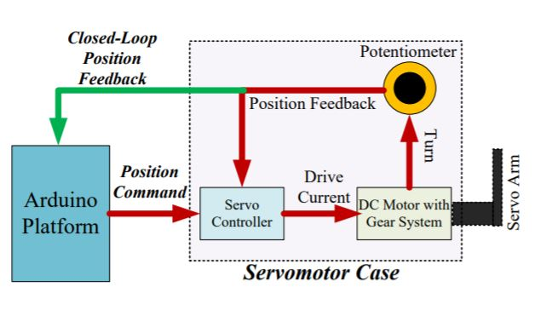
Servomotor working

Slide 29
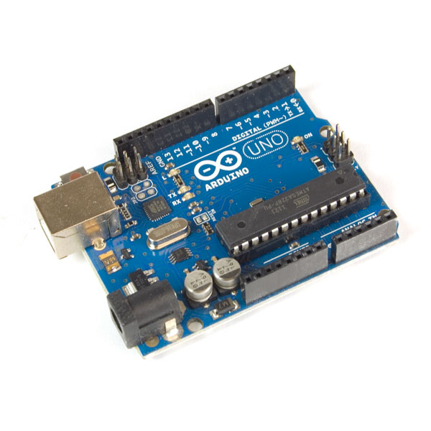
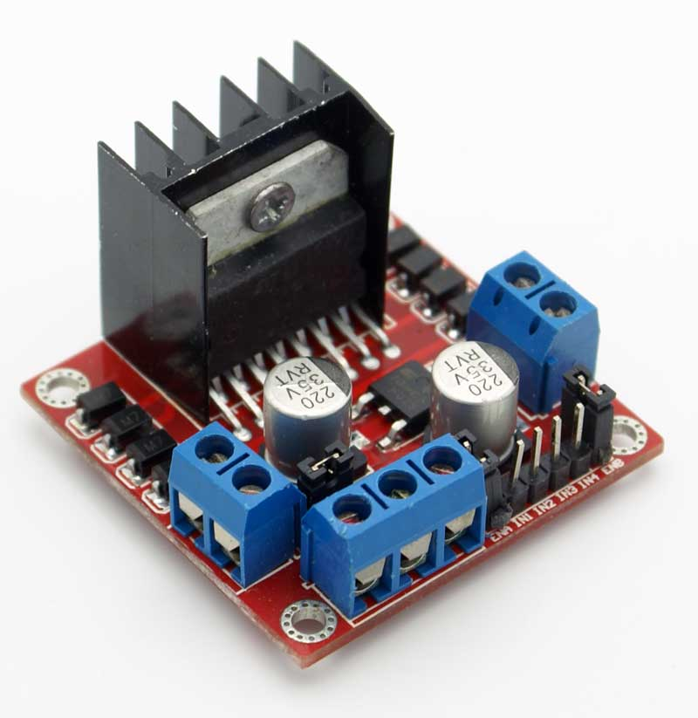
L298n driver for motor control and Arduino Uno 8 bit
microprocessor.

Slide 30
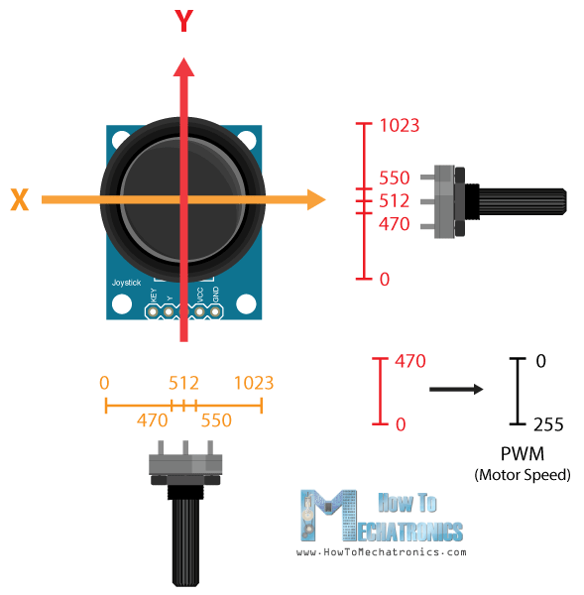
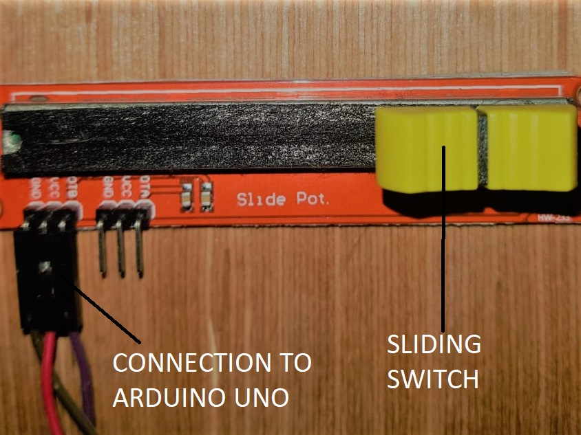
Joystick and Linear slider

Slide 31
Electrical and Electronics
Component | Application | Requirement
DC motor | Hub Motor | Holding constant speed, easy to control, economical
Servo motor | Rear wheel steering | Precise position control, 180˚ movement, no driver needed
Stepper Motor | Front geometry steering | Holding torque, precise position control, wide range of motion
Arduino UNO | Controller board | Well documented, economical, enough INPUT/OUTPUT pins
L298N driver | DC motor & stepper motor driver | Current Capacity, documentation and Arduino compatibility, economical

Slide 32
Slider Correction
Input for steering the vehicle is taken from a 10k ohm sliding potentiometer, which converts position of slider to an electronic signal (0-5V) that can be transmitted to the Arduino.
This 0-5V analog input is converted into a digital equivalent step between the 0-1023 points of the sliding potentiometer by the Arduino.
During testing, it was identified that the output does not linearly change with the slider position, as it theoretically should. This was creating reduced sensitivity at the extremes, and very high sensitivity at the mean position of the slider. To rectify that, multiple data points were selected, followed by plotting the distance vs. input graph for the potentiometer.
To fix this, a function was added in the code that changed the input and got it closer to the ideal line.
For this, the slider input is divided into three parts, where Part 1 is from 0 to 60, Part 2 is from 60 to 977 and Part 3 is from 977 to 1023.
These values are approximated from the graph above. Then the slope and extent of each Part was mathematically modified to conform to the ideal graph.

Slide 33
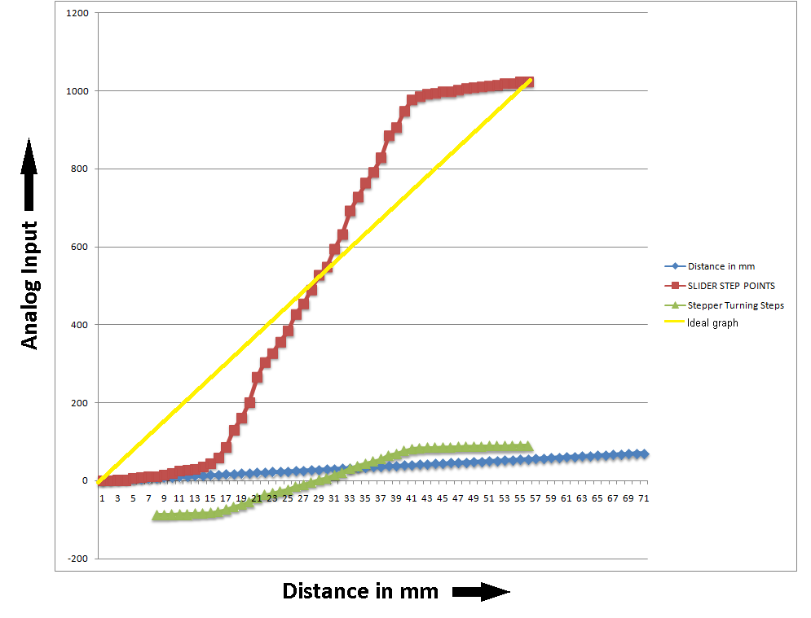
Slider Correction

Slide 34
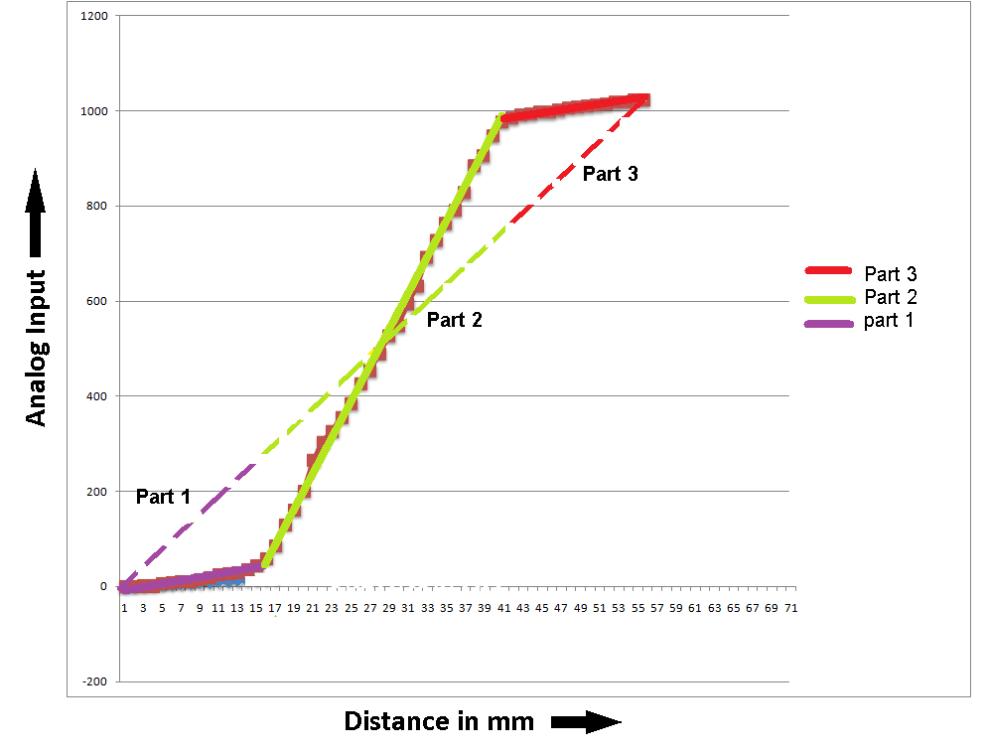

Slide 35
Hydraulic Design
In this project, the mechanical and the electronics are accompanied with a hydraulic system that has been developed in order to facilitate the change to zero turn steer. This project does not utilise pneumatic systems because of the compressibility of air. This can induce play in the system, thereby affecting the steering capabilities. Hence, in order to change the effective rack length, two hydraulic syringes were attached that can extend up to 50 mm each. 100 mm total extension turns the front wheels in opposite direction, providing the toe-in required for zero wheel steering.

Slide 36
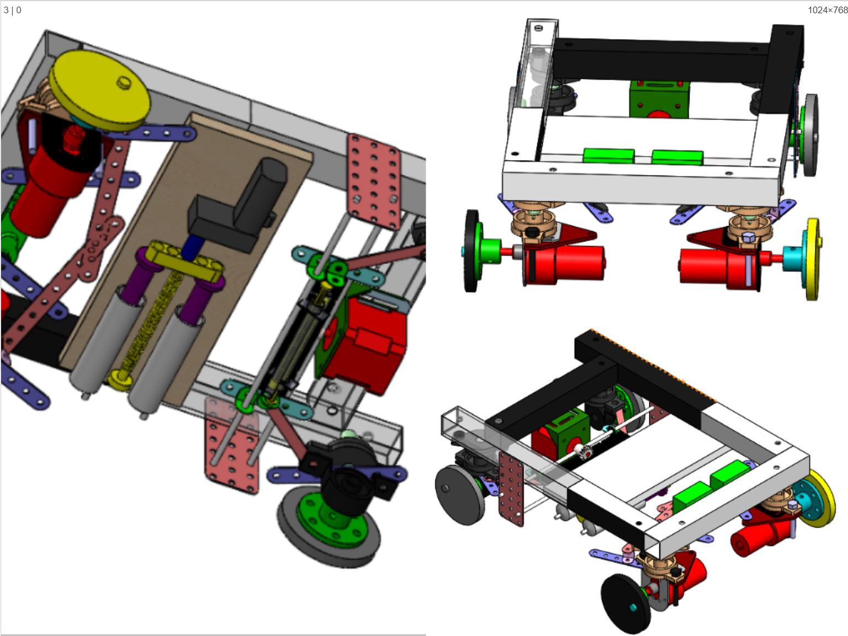
Final Prototype

Slide 37
A high torque DC motor is used to provide the necessary torque for the turning motion necessary to actuate the main syringes, and modulate the length of rack syringes.
This motor is controlled by the L298N driver which allows running it for a very precise amount of time (Arduino controlled), and also gives the ability to reverse to normal 4WS mode.
A 5mm to 5mm coupling was attaches the DC motor to the screw, to transmit the rotating motion.

Slide 38
Testing results
S. No | Inner Angle | Outer Angle | 2W- TCR | 4W-TCR | Experimental % reduction
 | (degree) | (Degree) | (mm) | (mm)
1 | 45 | 23 | 752.90 | 383.20 | 49.10
2 | 44 | 23 | 880.20 | 405.82 | 53.89
3 | 43 | 23 | 943.60 | 427.07 | 54.74
4 | 42 | 22 | 1001.40 | 444.82 | 55.58
5 | 41 | 22 | 1054.05 | 459.29 | 56.43
6 | 40 | 22 | 1113.20 | 459.40 | 58.73
7 | 39 | 21 | 1145.82 | 480.29 | 58.08
8 | 38 | 21 | 1186.06 | 487.75 | 58.88
9 | 37 | 21 | 1223.23 | 493.81 | 59.63
10 | 36 | 20 | 1257.87 | 498.90 | 60.34
11 | 35 | 20 | 1291.10 | 516.70 | 59.98
12 | 34 | 20 | 1321.64 | 508.22 | 61.55
13 | 33 | 19 | 1351.84 | 513.32 | 62.03
14 | 32 | 19 | 1381.61 | 519.36 | 62.41
15 | 31 | 18 | 1411.49 | 526.80 | 62.68
16 | 30 | 18 | 1312.80 | 533.00 | 59.40
17 | 29 | 18 | 1473.66 | 547.74 | 62.83
18 | 28 | 17 | 1351.80 | 562.17 | 58.41
19 | 27 | 17 | 1542.50 | 579.88 | 62.41
20 | 26 | 16 | 1580.91 | 601.31 | 61.96
21 | 25 | 16 | 1723.60 | 623.50 | 63.83
22 | 24 | 16 | 1667.80 | 675.25 | 59.51
23 | 23 | 15 | 1717.60 | 692.69 | 59.67
24 | 22 | 15 | 1772.17 | 733.74 | 58.59
25 | 21 | 14 | 1832.13 | 780.85 | 57.38
26 | 20 | 14 | 1863.10 | 836.20 | 55.11

Slide 39
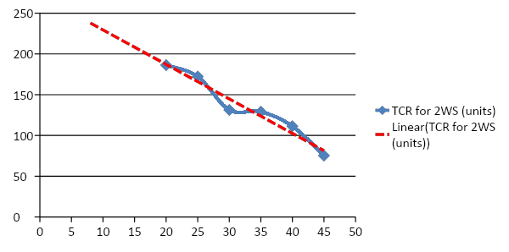
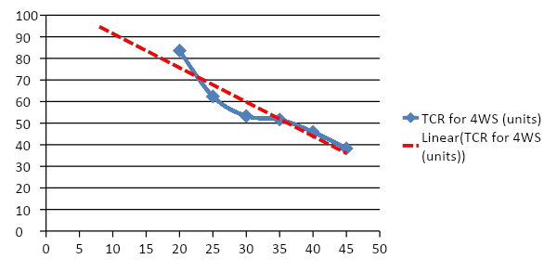
Result Interpretation
The values were plotted and a trend line was obtained, which was then plotted to a third degree polynomial. These graphs are plotted as shown .
This polynomial offers a chance to interpolate the values in between which further helps to understand the TCR reductions throughout the range.
The interpolated graphs are third degree polynomials with maximum fit.
Coefficient of goodness of fit :-
0.96 for 2WS data
0.99 for 4WS data.

Slide 40
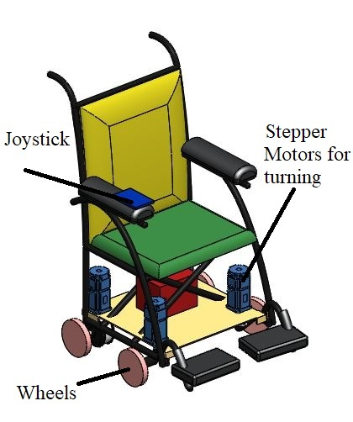
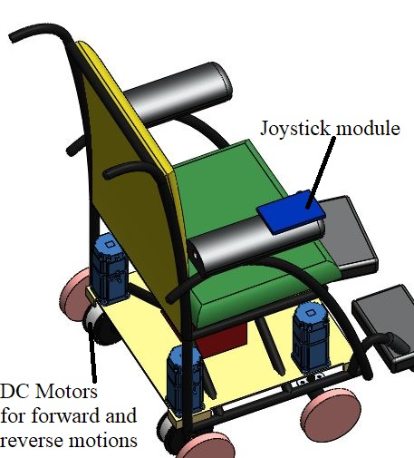
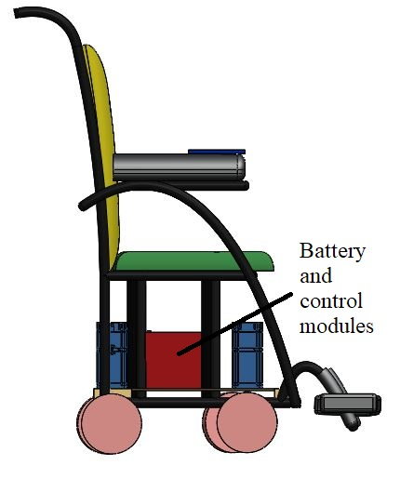
Wheelchair Design
The battery is selected based on the requirement of wheelchair range of 15km. The battery is a 24V Li-ion pack with 11000mAh current capacity.
Hub motors in the wheels which are used for propulsion.
4 Stepper motors steer the vehicle
The prototype is also equipped with a battery pack that is mounted at the underside of the wheel chair.

Slide 41
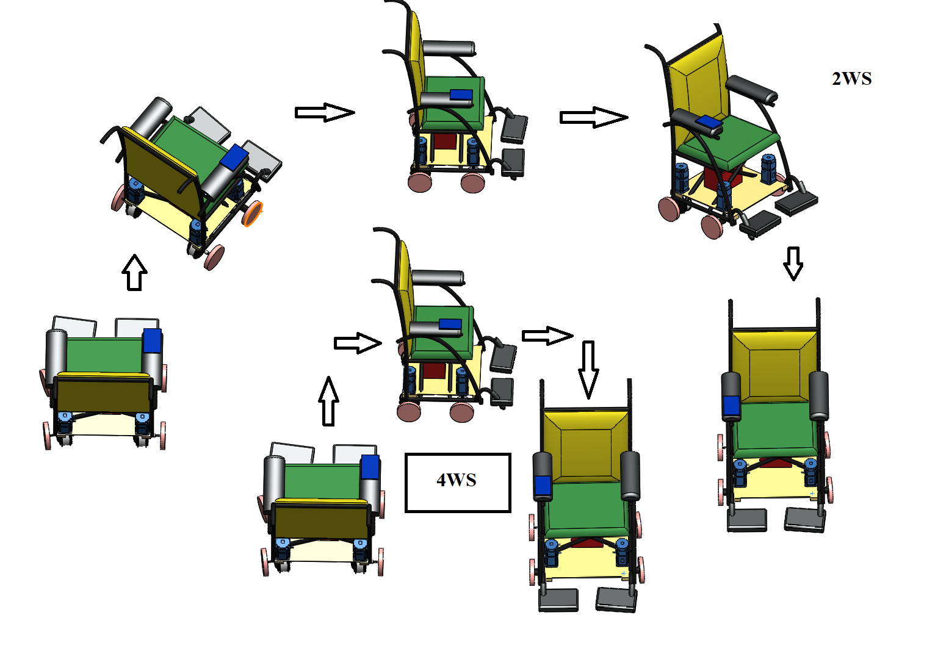

Slide 42
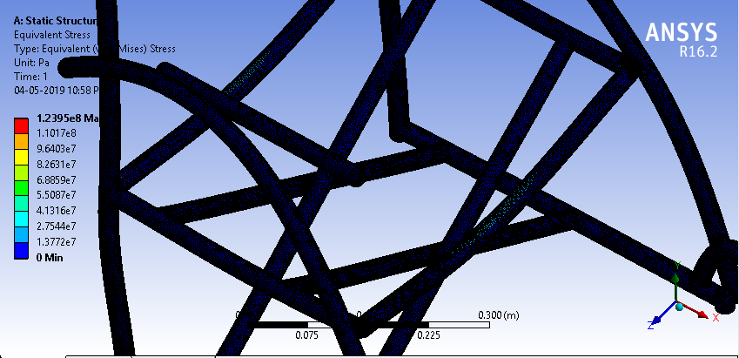
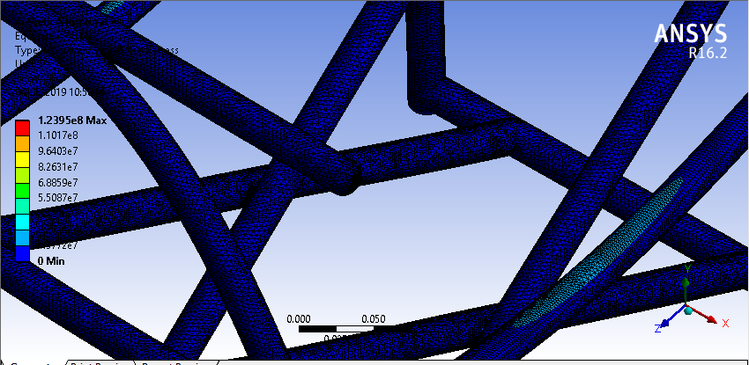
ANSYS Simulations
Simulation was performed on ANSYS Workbench 16.2 under the static structural module.
The CAD for the frame was designed on SolidWorks 2016 and imported to ANSYS. The auto mesh feature was used to mesh the geometry.
With curvature relevance set to 50%, high smoothing, slow transition and span angle centre set to fine. A vertical load of 250 kg was estimated.
The Results of the Simulation show that the frame has a healthy safety factor of 2.017 (generally > 1.5 is deemed acceptable) under these extreme loading conditions. The maximum stress is safely below the yield stress. The simulation is shown in Figure 4.11

Slide 43
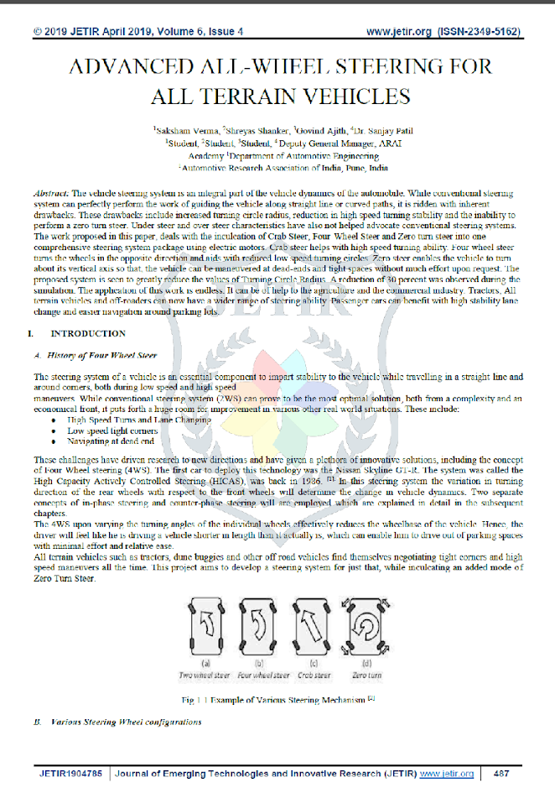
Journal Publication

Slide 44
References:
C. Johanson, Auto suspension and steering, 4th edition, The Goodheart Willcox 2015
W.F. Milliken, Race Car Vehicle Dynamics, SAE International, 2003, 1995
W.H.O “Guidelines on the provision of manual wheelchairs in less resourced settings” WHO, Geneva, 2008
Nick, www.supercars.net 25 February 2016 [Online] [Accessed December 18]
P Amol, “Study of Four Wheel Steering Mechanism, “International Journal of Modern Engineering Research, vol.6, no.19, pp.31-34 2016

